Slide 1

Cold Chain Management and Continuous Temperature Monitoring in Mozambique
TechNet-21 Conference, October 2017
Presenter: Balbina MARIO
EPI National Logistician
Mozambique MoH (misau)

Slide 2

In-country challenges with cold chain performance
More than 10 different brands and types of refrigerators are installed in HF across the country ---- making storage of necessary spare parts and required technical knowledge to conduct maintenance
Paper-based temperature monitoring forms are supposed to be completed twice a day but are usually done incorrectly or incomplete – giving the wrong information of cold chain performance
Each province has only 1 cold chain technician – who usually is responsible for CCE in over 100 HF, 10-15 district depots, and province warehouse -- technician’s time to fix problem fridges is hampered by lack of information on the problem and how long it’s been happening

Slide 3
Evolution of Cold Chain RTM in Mozambique
Notes:
Give brief history on the cold chain in the country (looking at RTM implementation; CCEI; Any other pilot we’ve done (The ColdTrace for transport)
2014 MoH decided to remove all analogic thermometers to replace them with RTM devices (coldtrace, fridge tags, etc)

Slide 4
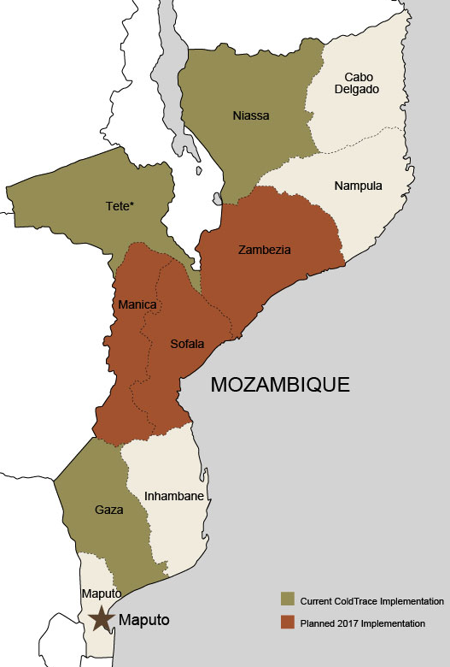
RTM - ColdTrace in Mozambique
Will be expanding from 3 to 6 provinces in 2018
Pilot Provinces (in Green) | # of Devices (210)
Gaza | 86
Niassa | 76
Tete | 48
New Provinces (in dark red) | # of Devices (649)
Manica | 193
Sofala | 174
Zambezia | 282
Notes:
Why Expand? – Give brief explanation of the NLWG workshop that was the decision point to expand the CT RTM nationally. Because:
Decide to remove analog thermometers and move to RTM because it is more safe
We had convincing results from the initial CT pilot that helped us make the decision to do the expansion
We also wanted to include other RTM devices so the expansion decision is:
(1) ColdTrace in Health Facilities and District Depots that have fridges and good network connectivity
(2) Fridge Tags in Health Facilities and District Depots with poor network connectivity
(3) Beyond Wireless in National Depot and Provincial Warehouses because they are cold rooms and not refrigerators
Cold
Cold

Slide 5
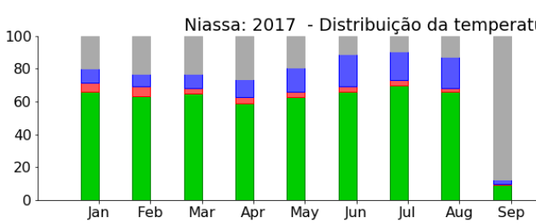
Benefits of ColdTrace
Through ongoing use of ColdTrace, more than 60% of fridges using CT in Niassa province are within the ideal temperatures – example below from 2017
  Why is this?
  ColdTrace sends alerts that drive immediate action for repair of fridges
  Remote help can be provided to technicians
  Monthly Reports and dashboards give visibility into CC performance
Notes:
What is ColdTrace:
- A device that send temperature data, SMS messages and alerts that notify users of temperature excursions and power outages;
- SMS alert to the health center nurse when the refrigerator is outside of the 2°C-8°C range, with escalated alerts when necessary.
- An online data dashboard showing power outages and refrigerator performances;
- Monthly status reporting emailed to managers in PDF format.

Slide 6
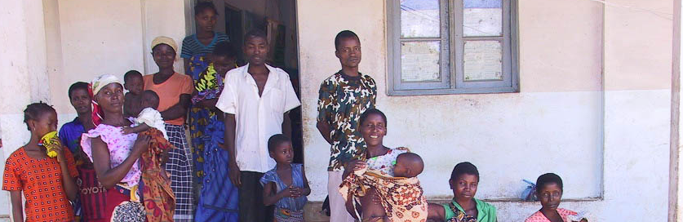
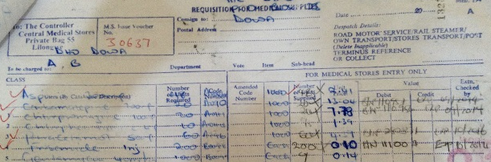

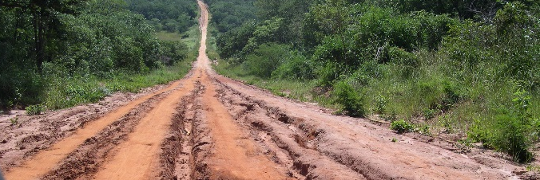

Cold Chain Equipment Inventory-data collected
1638 Health Facilities inventoried (includes Provincial and Districts)
Health Center Information – GIS locations
Cold chain equipment:
Fridges, freezers, etc.
Transportation at health facility: motorcycles
Human Resources
Notes:
For the Cold Chain Equipment inventory, we focused on getting information about several areas.
The questionnaire was divided into 7 groups, namely:
- General data of the Health Unit or the Deposit;
- Fridges / Freezers;
- Isothermal Boxes;
- Temperature Monitoring Devices;
- Repair Kits and Accessories for Glaciers;
- Motorcycles;
- Human Resources;

Slide 7
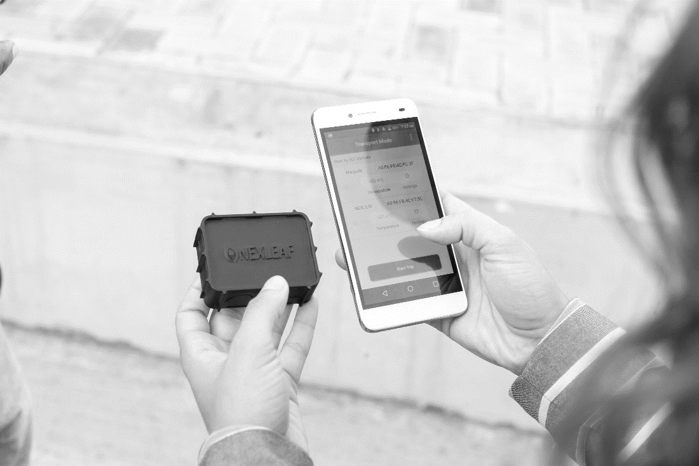
What will we do with this inventory data?
  It will inform the creation of a national CCE expansion plan which will be used to guide the Mozambique 2018 CCEOP Procurement Plan.
  It will also be used to create a tailored maintenance plan, based on the CCE available in each region.
  It will be used to determine placement of ColdTrace and Fridge Tag devices
Notes:
We hope at the end of the pilot:
Data driven report on the most common temperature problems in transit; potential for data mapping of which routes / areas experienced the highest rate of alarms to inform trip duration and route planning
Identify best practices for sensor placement and vaccine packing in vehicles.
Insights on challenges seen during transport.
Calculations of the total cost of ownership for temperature monitoring during transport.

Slide 8
RESULTS of the CCEI (1638 sites)
80% of Cold Chain Equipment in good condition or repairable
97% of facilities have access to network coverage
More than 60% of country CCE are Dometic fridges
Around 80% of Health Facilities have Temperature Monitoring (74% of those are thermometers; rest are Fridge Tags or ColdTrace)
19% of current CCE is not working and cannot be fixed
Notes:
This is latest data we have from the Cold chain inventory - The data for the National Depot is pending further details to be marked as complete, i.e., data is being completed with the support of the EPI team and CC Managers. We collected data for 1638 locations
Other stats that might be interesting to showcase:
88% of (active or awaiting repair) CCE is runs on electricity
95% of facilities have at least one working/repairable or not installed CCEI
3% of new CCE is still to be installed
14% of existing CCE is not working but can be fixed

Slide 9
Key takeaways/learnings for other countries
List some of the key lessons you have learnt from Mozambique about:
Prompt response from the health facility staff to SMS alerts and responding to CCE failures quickly
Escalated alerts, monthly reports, and dashboard visualization for managers and technicians to ensure communication flow about CCE failures
Visibility and awareness about storage conditions of vaccines and protecting the vaccine potency

Slide 10
Key takeaways/learnings for other countries
SOPs and processes to ensure RTM data informs decision making
CCE performance data from RTM can update CCE inventory and therefore inform CCE procurement planning (such as CCEOP application)
CCE performance of different models can inform the country’s maintenance strategy
Importance of integration of cold chain data into SELV (vaccine logistics electronic system)

Slide 11
Thank you!
For more information, please contact:
Balbina Mario, EPI National Logistician, Mozambique MoH (MISAU)
bkhanlawia@gmail.com

